Slide 1
Co-design Group project "Klondike Solitaire"
Mikhail Krasnikov Alexey Mazyar Valeriya Zhilyaeva 21213

Slide 2
Rules
Klondike solitaire is a card game with 4 decks of 8 cards.
The goal of the game is to arrange all the cards in descending order.
When you complete 8 cards from 9 to 2 card stack disappears.
To move cards, push button where you want to move card or cards then push button where is the card now and run command.
If the player can no longer make any meaningful movements, the game is considered lost.

Slide 3
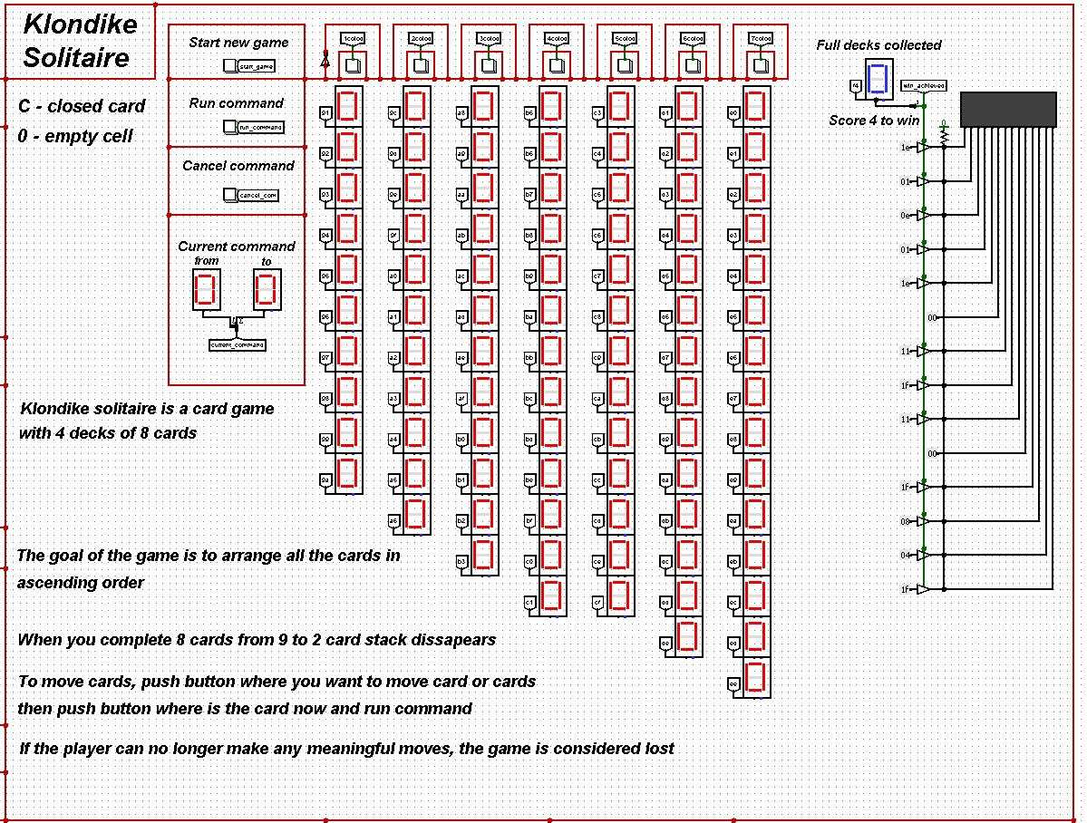
Game Pad

Slide 4
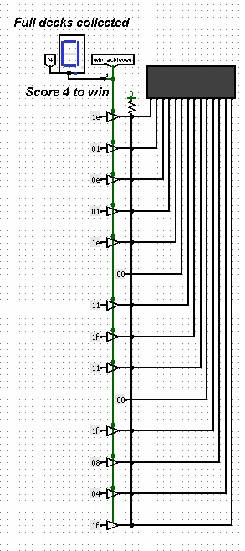
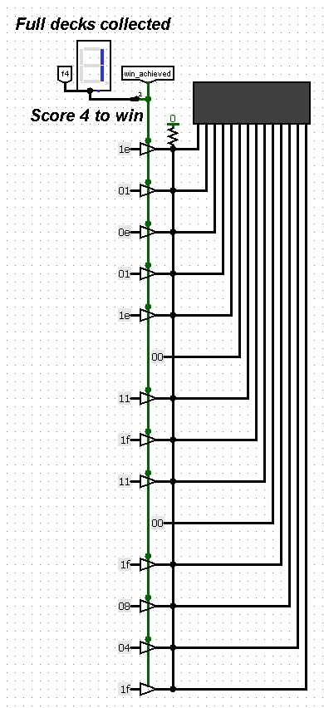
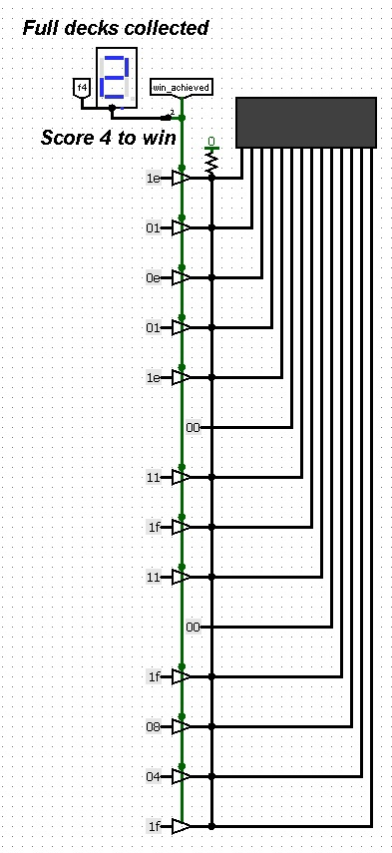
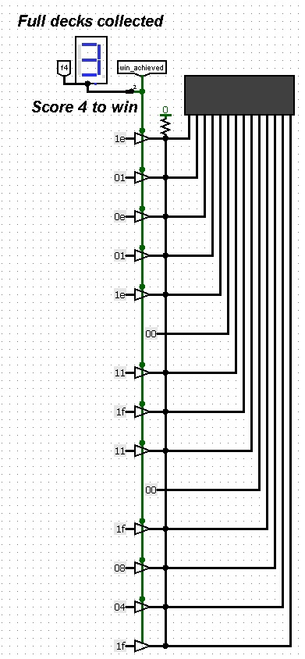
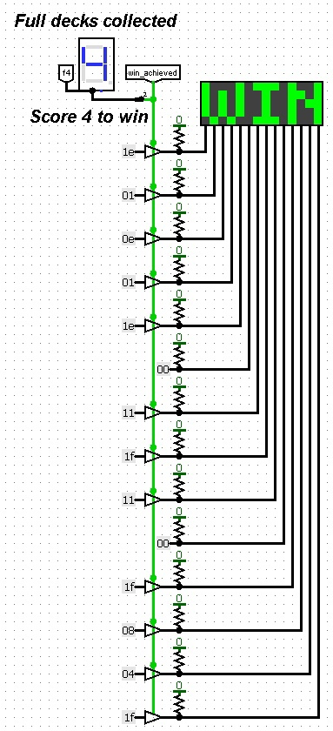
The beginning of the game Winning

Slide 5
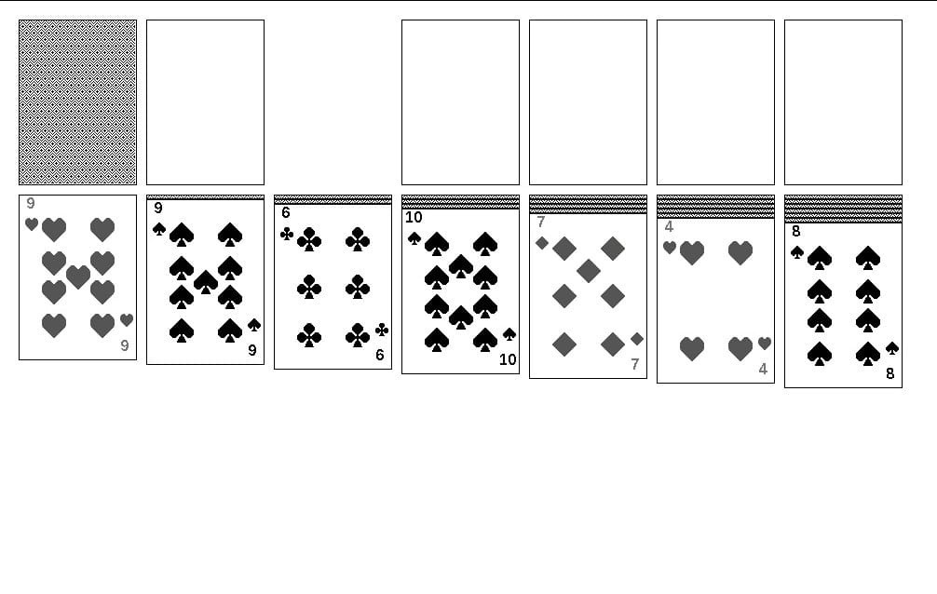
Prototype

Slide 6
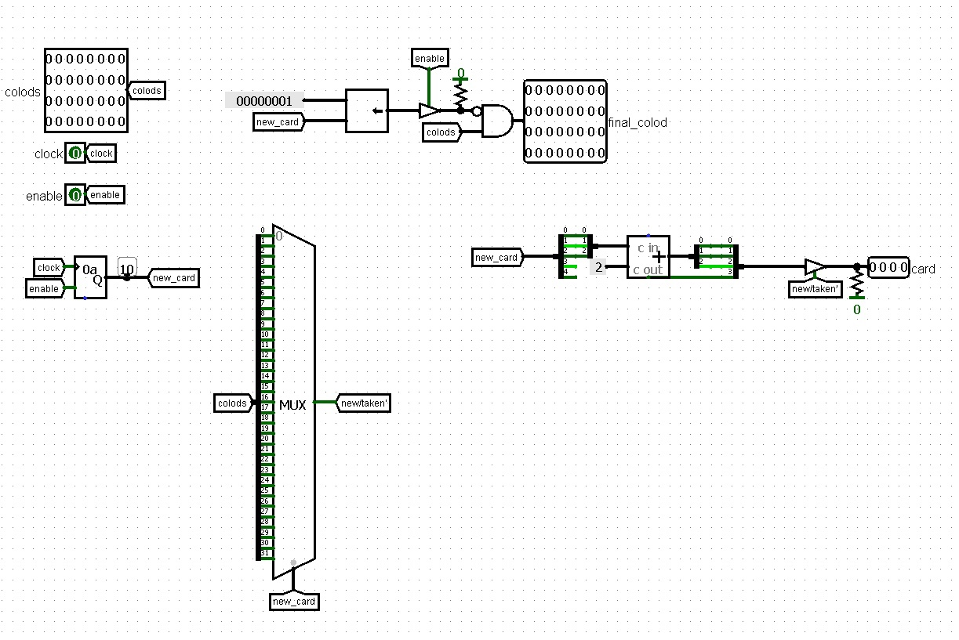
Hardware Configuration
The function selects one card. Used in the generator function. It is implemented on a bit array, if the card is used, those in the bit array are zero, then zero is output, otherwise a number from 2 to 9 is output, each bit has its own value.

Slide 7
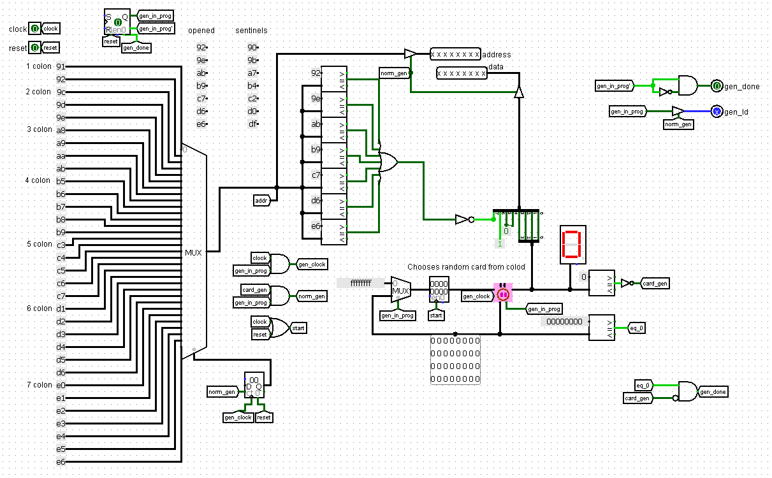
Generator function
The function goes through all addresses and assigns them a specific card. The card is called by the configuration functions, if it already was, then zero is output. Then there is a comparator that checks whether the card is equal to zero, if it is equal, then the register that changes the address does not change anything, ignoring this occurrence and generates the card again, so it will be until it is equal to zero. Then this card will be written to this address, it will all be output to main, where it will all be written to RAM.

Slide 8
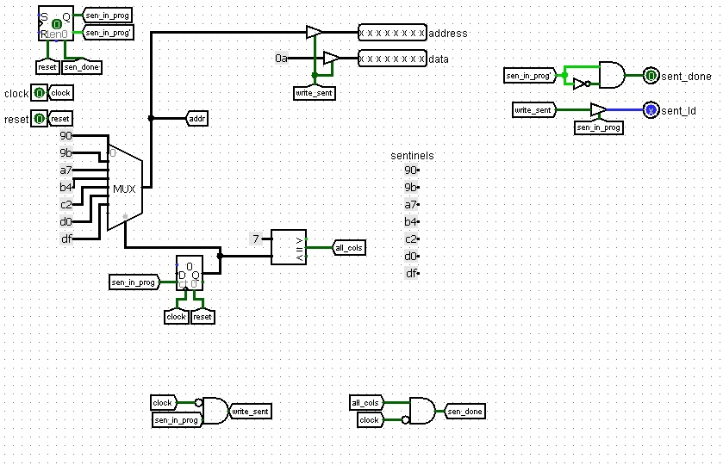
The write_sentinels function
A function that writes auxiliary elements to certain addresses (10). 10 will not be displayed on the indicator, they serve for the convenience of programming.

Slide 9
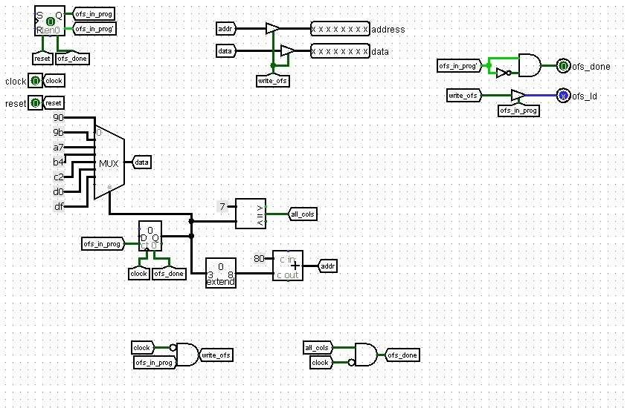
The write_offset function
As a write_sentinels function, write_offset function writes auxiliary elements to certain addresses (10). However, there is a set of addresses that are selected by the multiplexer (the addresses of the beginning of the deck), and a register (from 80 to 86).

Slide 10
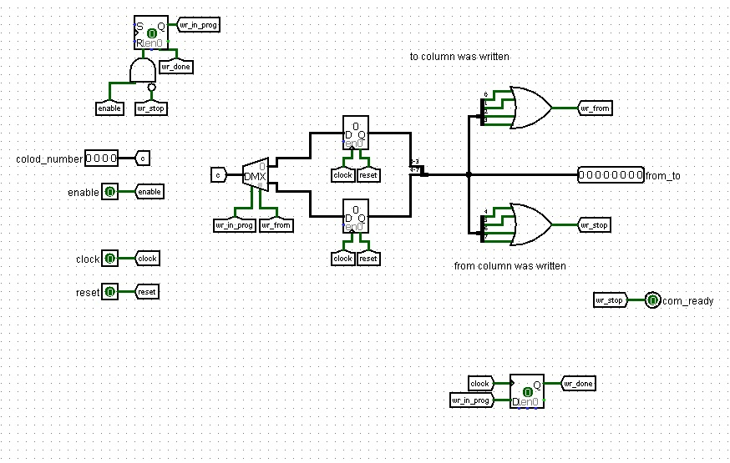
The card_replace function
When we click on the button with the deck number, this button is viewed and sent to the function. Then the tunnel looks, if both the first and second four bits are recorded, then the move is complete, then in main you need to press the run command button to start the command.

Slide 11
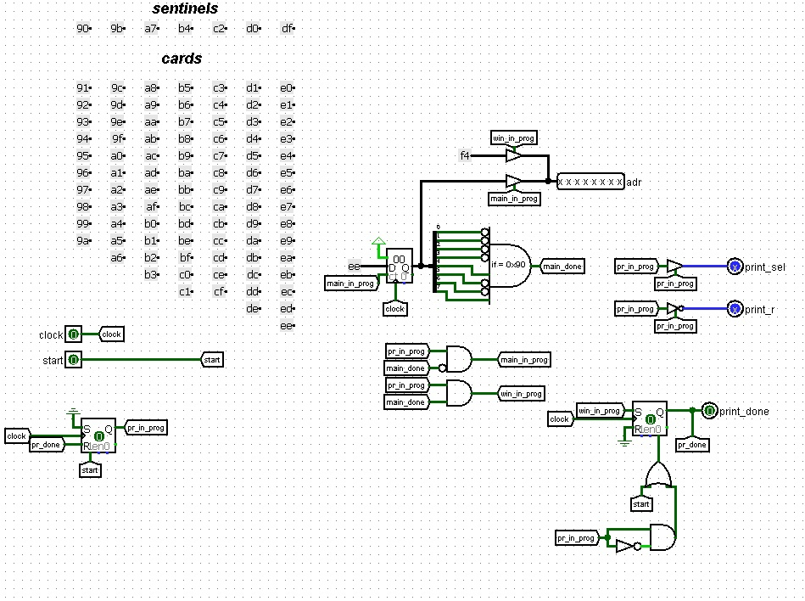
The print_cards function
We run through the EE addresses up to 90 in reverse order using the counter, signaling the RAM so that it puts the value of the card lying at this address on the data bus. After that, the address F4 is also supplied to print the number of discarded decks.

Slide 12
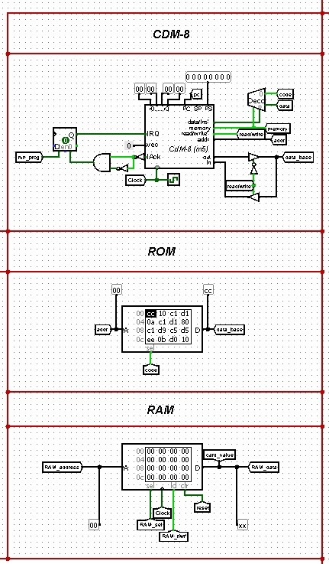
The main has RAM, which has two connection options – the processor and the circuit, the choice depends on the moment of the game – if the deck is generated, then the circuit is connected, if the cards are moved, then the processor

Slide 13
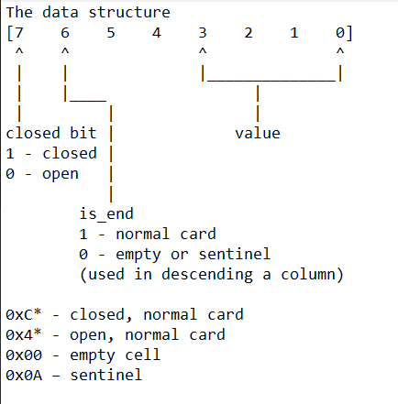
Software

Slide 14
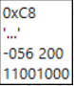
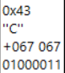
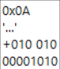
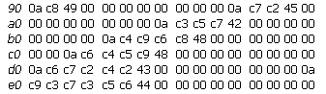
Decks are arrays of different lengths, the beginning of one immediately follows the end of the other. At the beginning of each deck, there is a "sentinel" - an auxiliary cell with the value 0x0a. The sentinel value is 10, which allows you to put a nine in the place of an empty deck, as if on a ten, without unnecessary checks
closed card
open card
sentinel
deck

Slide 15
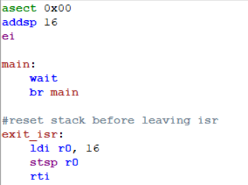
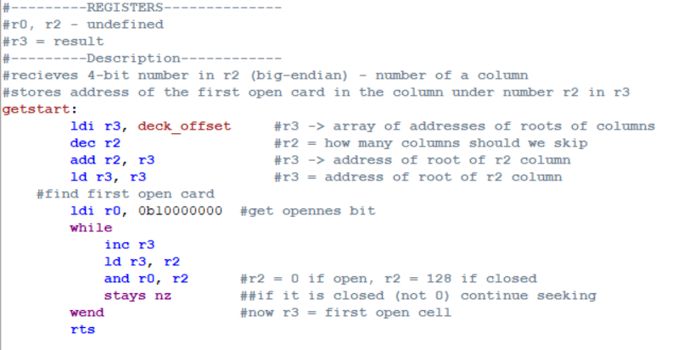
getstart function
Work with interrupts is provided by main and exit_isr

Slide 16
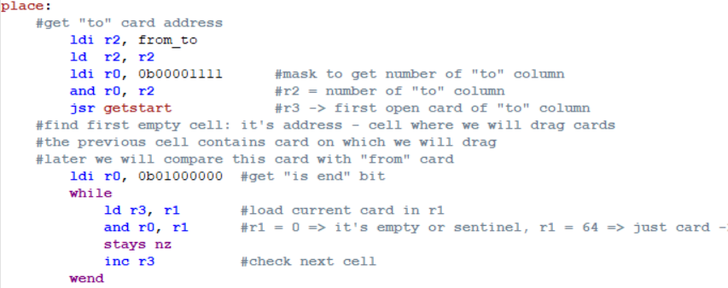
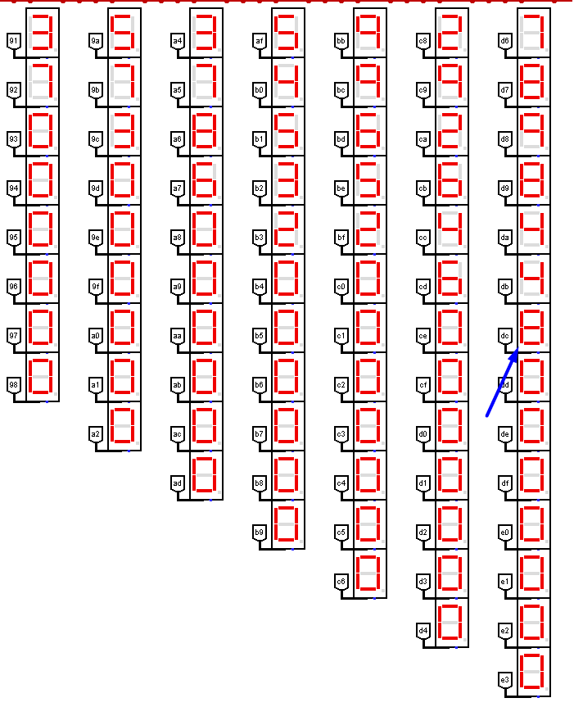
Structure of the main program
Destination card: finds the last open card of the deck, where cards will be folded.
Example:transfer to the last column

Slide 17
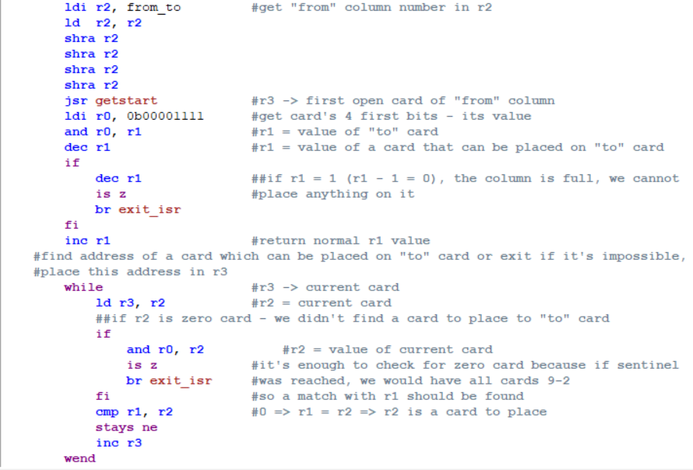
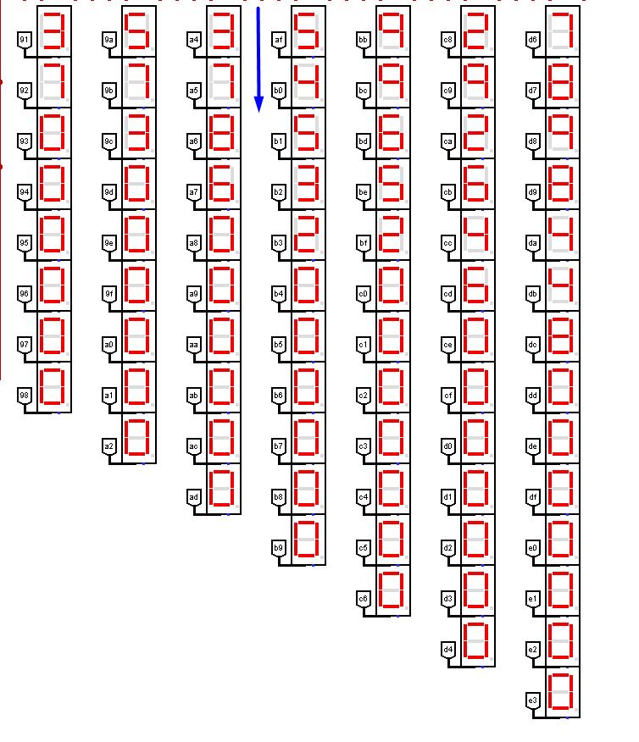
Search for the appropriate card: search for the first open card of the deck, from where we will shift. In r3, using the getstart function, we save the first open card, from where we will take. r1 stores the card that the deck will move to. Checking for the end of the deck. search for a card that can be put.
Example: transfer to the 8th card from the 3rd deck, therefore the search for the 7th

Slide 18
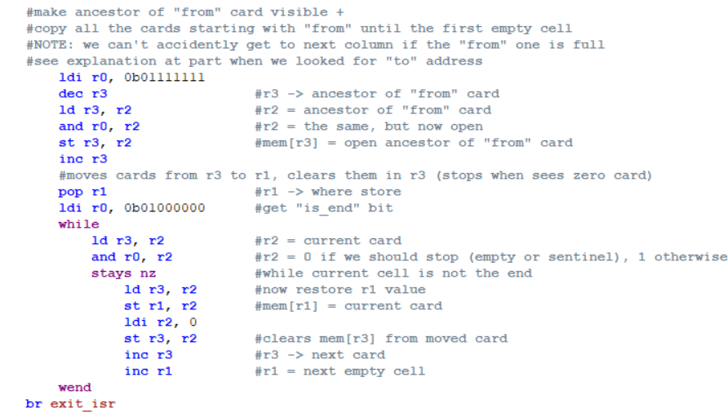
Transferring cards: open the previous card. Transfer of the card.

Slide 19
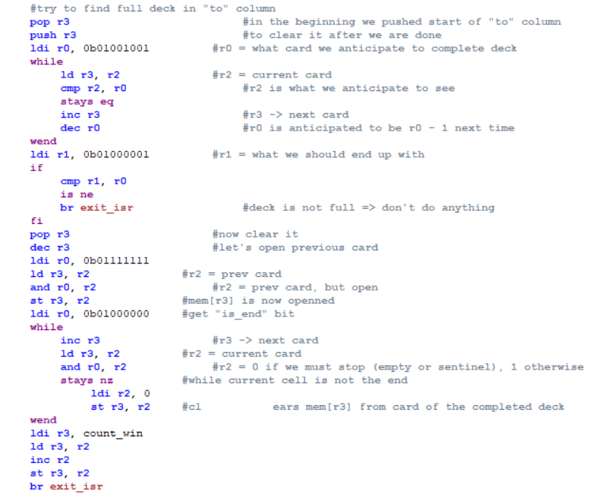
Checking full card stack
Let's determine whether the full deck has been assembled. We run through a column where we placed cards and if it is descending from the 9. After the cycle, check all the cards from 9 to 2 have been seen. Next we open the card on which lies the 9 and delete the complete column. Next, we increment the number of discarded decks

Slide 20
Thank you for your attention!

